Slide 1
Understanding the human being as co-existence of the self and body:-
Introduction and Meaning:-
Human being is more than just a body. Human being is a co-existence of the ‘Self’ and the ‘Body’. There is a need to understand human being not only as human body but also in context of Self which acts as observer or user of Body. Body is the physical appearance with a particular structure and features whereas Self is the aliveness of the person i.e. the entity that keeps the body.

Slide 2
Introduction and Meaning:-
‘Self’ ( I ) and ‘Body’ are different in terms of their needs. Needs of body are physical in nature. However, the needs of self are not physical in nature. Body needs food for nourishment, clothes for protection from different kinds of weather and some other facilities to ensure right utilization of body. These can be categorized as physical facilities or suvidha. Self ( I ) needs respect, happiness, trust etc. Thus, the need of Self is to live in state of continuous happiness.

Slide 3
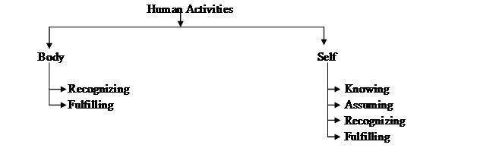
Understanding ‘I’ and ‘body’

Slide 4
Hence, for every human being, we need to fulfil the needs of both:
· Of “I” = Happiness (Sukha)
· Of “Body” = Physical Facilities (Suvidha)
One of these cannot replace the other.

Slide 5
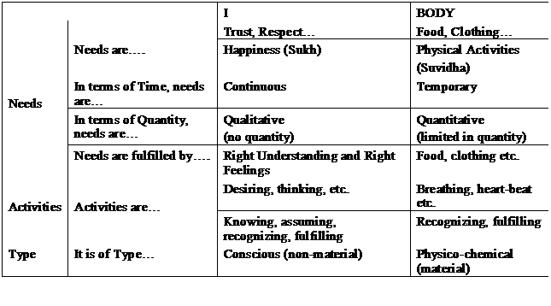

Slide 6
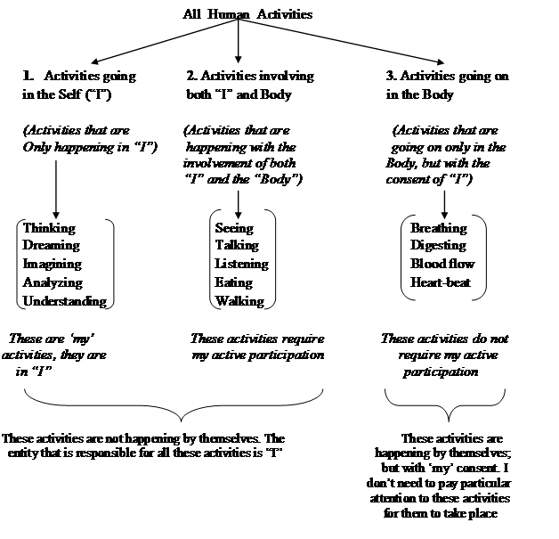
Understanding the Activities in the Self and the Activities in the Body:

Slide 7
Understanding human being as a co-existence of the sentient ‘I’ and ‘body’
All human activities can be put under three categories –
Activities that are going on in the Self (Sentient Activities)
Activities that are going on in the Body (Material Activities)
Activities involving both the Self and the Body

Slide 8
Activities that are going on in the Self (Sentient Activities)
Activities in the Self / Jivana:
Since “Jivana” is a conscious entity, in addition to “recognizing” and “fulfilling”, it also carries out activities of “assuming” and “knowing”.
In “I”, the activities take place in the following order:

Slide 9

Activities that are going on in the Self (Sentient Activities)

Slide 10
Activities that are going on in the Body (Material Activities)
The body is a set of “Self-organized activities” that occur with my (I) consent but without my(I) participation.
e.g. : The functions like breathing, digestion, organ functions
However some of these activities can be stopped by me (I) if I want. e.g.: breathing

Slide 11
The activities in the body can also be understood as the mutual interaction between two material entities for “recognition” and “fulfilment” of their relationship.
e.g.: “Body” recognizes its relation with “Water” and fulfils it (by absorbing the water we drink, to the extent needed and uses it for the nourishment of various organs).

Slide 12
Examples of Activities of the Body Vs Activities of the Self:
Example 1:
Activity of the Body: If a needle is pricked into your body, the needle goes inside if it is sharp and does not go inside if it is blunt.
Activity of the Self: If you (I) see the needle being pricked into your body, you oppose it because you that it is a needle and you assume that it is sharp. Your “Recognition” of this fact makes you avoid it (Fulfilment of your Recognition).

Slide 13
Examples of Activities of the Body Vs Activities of the Self:
But if you “know” that it is a syringe with a needle, then you assume that it will cure you of your sickness. Then this “Recognition” makes you allow the needle to be pricked into your body (Fulfilment of your Recognition). Thus this different Recognition leads to a different fulfilment.

